Slide 1
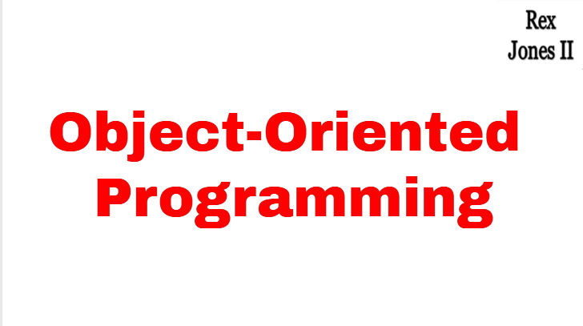

Slide 2
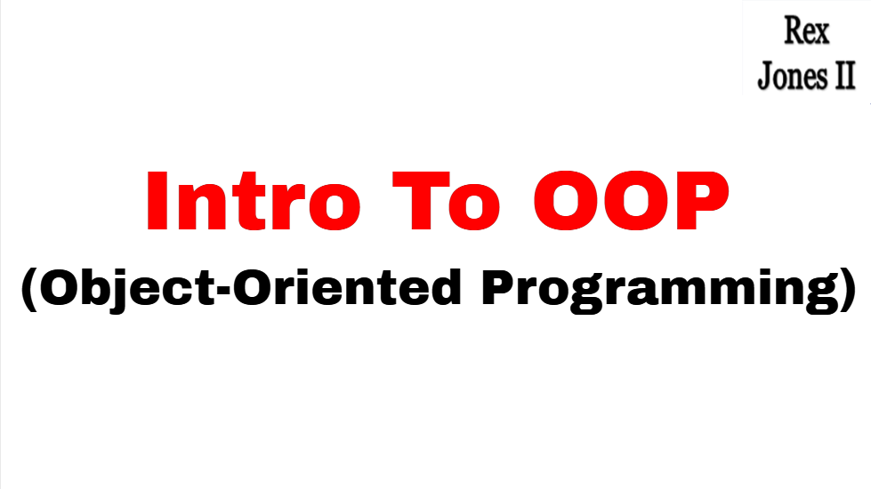

Slide 3
Structured Programming
An Employee works at a company
calculateSalary {
// Calculate Salary
_______________ _______________
}
Submit Resume
Attend Interview(s)
Get Hired At Company
Perform Job Responsibilities
Receive Paycheck From Company
calculateBonus {
// Calculate Bonus
_______________ _______________
}
calculateHealthBenefits {
// Calculate Health Benefits
_______________ _______________
}

Slide 4
Object-Oriented Programming
An Employee works at a company
class Employee {
int age;
int employeeID;
String title;
calculateSalary {
// Calculate Salary
_______________ _______________
}
calculateBonus {
// Calculate Bonus
_______________ _______________
}
}
Submit Resume
Attend Interview(s)
Get Hired At Company
Perform Job Responsibilities
Receive Paycheck From Company

Slide 5




OOP vs Structured
Structured Programming
Object-Oriented Programming
calculateSalary {
// Calculate Salary
_______________ _______________
}
class Employee {
int age;
int employeeID;
String title;
calculateSalary {
// Calculate Salary
_______________ _______________
}
calculateBonus {
// Calculate Bonus
_______________ _______________
}
}
calculateBonus {
// Calculate Bonus
_______________ _______________
}
calculateHealthBenefits {
// Calculate Health Benefits
_______________ _______________
}

Slide 6
Classes & Objects
Employee jane, john;
jane.age = 25;
jane.employeeID = 34;
jane.title = “Automation Engineer”;
jane.calculateSalary();
jane.calculateBonus();
john.age = 55;
john.employeeID = 99;
john.title = “Automation Engineer”;
john.calculateSalary();
john.calculateBonus();
class Employee {
int age;
int employeeID;
String title;
calculateSalary {
// Calculate Salary
_______________ _______________
}
calculateBonus {
// Calculate Bonus
_______________ _______________
}
}

Slide 7
Video Tutorial Series
Encapsulation
Inheritance
Abstraction
Interfaces
Polymorphism

Slide 8
Video Tutorial Series
Encapsulation
Inheritance
Polymorphism
Abstraction

Slide 9
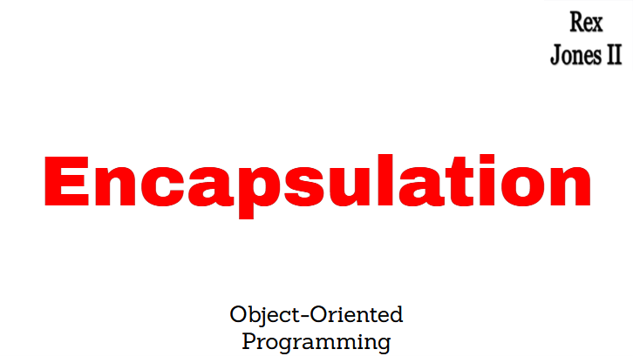

Slide 10
Video Tutorial Series
Encapsulation
Inheritance
Polymorphism
Abstraction

Slide 11
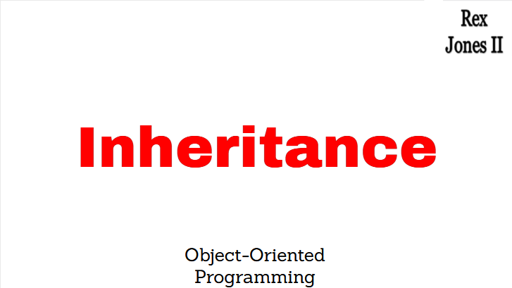

Slide 12
Video Tutorial Series
Encapsulation
Inheritance
Polymorphism
Abstraction

Slide 13
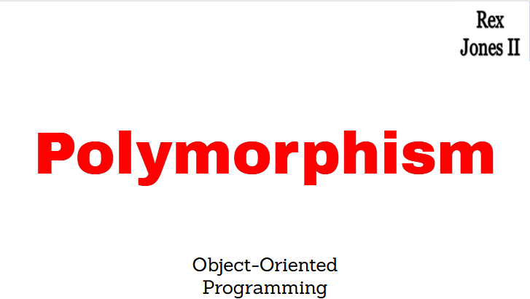

Slide 14
Video Tutorial Series
Encapsulation
Inheritance
Polymorphism
Abstraction

Slide 15
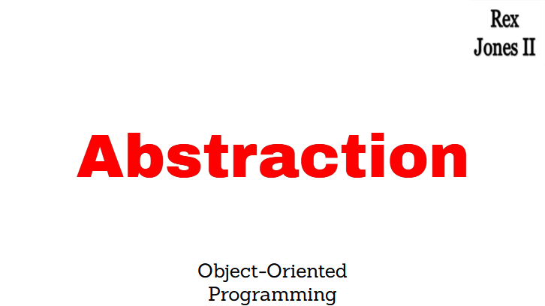

Slide 16
Video Tutorial Series
Encapsulation
Inheritance
Polymorphism
Abstraction

